Slide 1
Blood Bank Database
Group Members:
Muhammad Sunaam
Rohail Zulfiqar
Shehroz Khan

Slide 2
Business Rules
Blood Bank has the address, name, and contact information.
Blood Bank has blood inventory and donation history.
One patient can receive blood from one or more donors.
Each patient receives blood only through blood banks.
A donor can donate multiple times.
Each bank has a donation history.

Slide 3
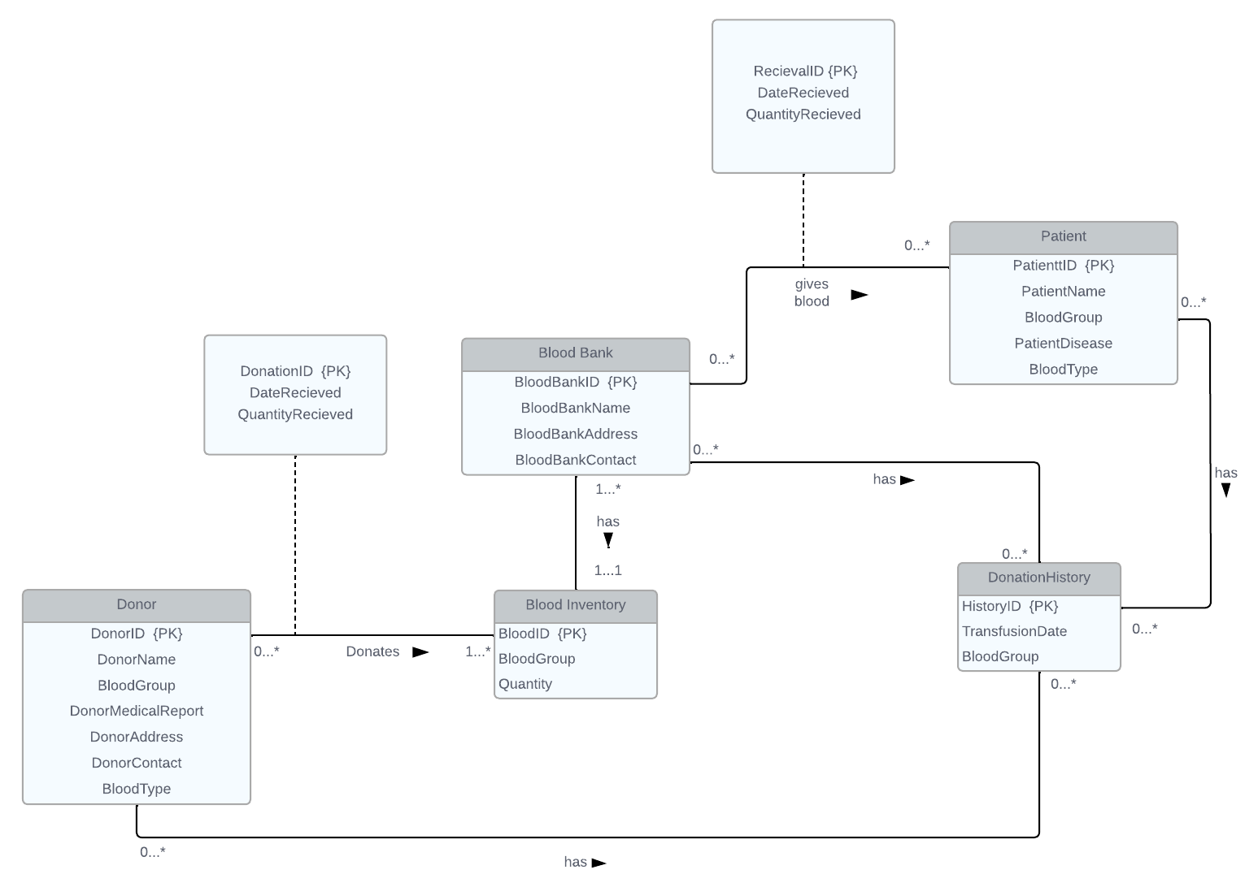
ERD Diagram (UML)

Slide 4
Thank You!

